Slide 1


Starbucks Marketing Plan Proposal- Exploratory Data Analysis Data Science Capstone Spring 2022 SECS 7259-01 22174
Roland Padilla

Slide 2
Variable Identification-Portfolio, profile and transcript files
We have reward (int), difficulty (int) and duration (int) as continuous values; where as channels (list of strings), offer_type (str) and id (str) as categorical data.
We have age (int), became_member_on (int) and income (float) as continuous values; where as gender (str) and id (str) as categorical data.
We have time (int) as continuous value; where as person (str), event (str) and value (dict of strings) as categorical data.

Slide 3
Missing Value Treatment
Missing data in the training dataset can reduce the power / fit of a model or can lead to a biased model because we have not analysed the behavior and relationship with other variables correctly. It can lead to wrong prediction or classification.
There are 8,077 missing values in each of the data variables 'gender' and 'income' (Both are part of the same record) of our dataset. Let's analyze these records alone to identify the reasons for occurrence of these missing values and the ways to treat it.
Replacing missing values with mean/mode/median wouldn't be a good choice; as there are a large amount of records with missing values, mean/mode/median imputation could convey false information to the model. Since there are three features to be identified KNN imputation would also be risky and inefficient. Thus, the better option would be to delete those records. (Even after deleting those records with missing value, we will have 55,255 records for modeling)

Slide 4
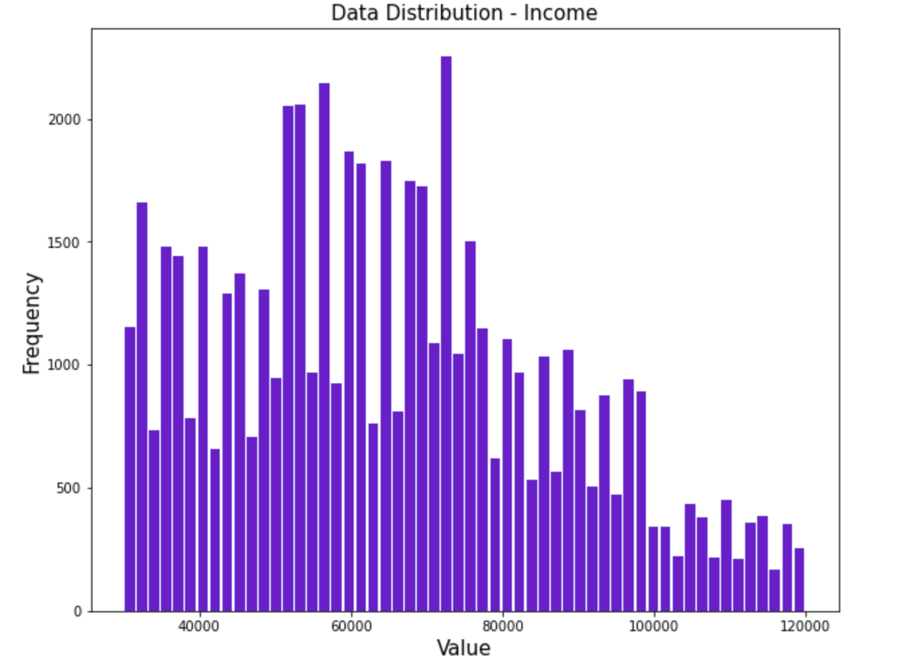
Univariate Analysis
This histogram gives us the idea that our dataset lacks records or datapoints of customers who has income between 70,000 and 120,000. It's essentially a distribution which is positively skewed or right skewed. So in skewed data, the tail region may act as an outlier for the statistical model and we know that outliers adversely affect the model’s performance. Hence, we may need to normalize the data afterwards.

Slide 5
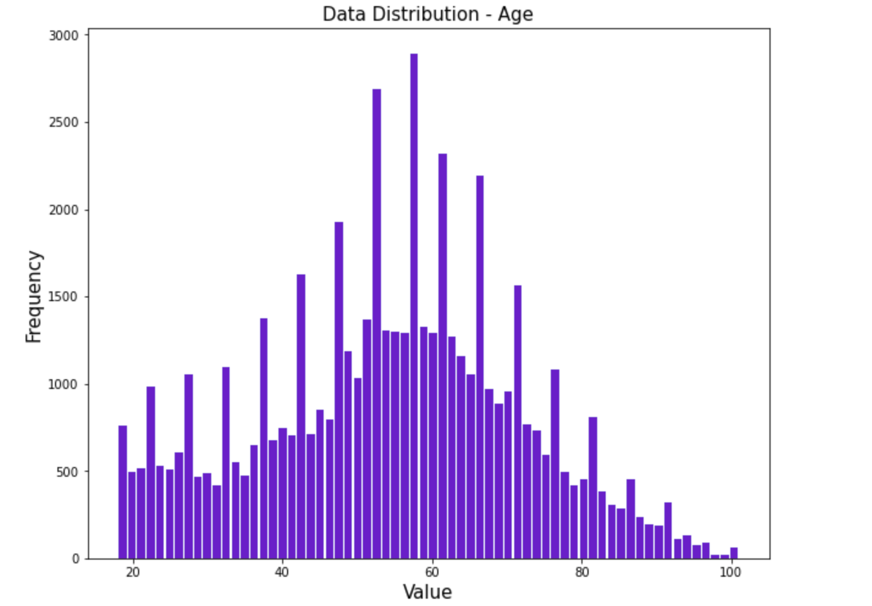
Univariate Analysis
The distribution of the variable ‘age’ in the dataset is positively skewed or right skewed. Hence, we may need to standardize the same.

Slide 6
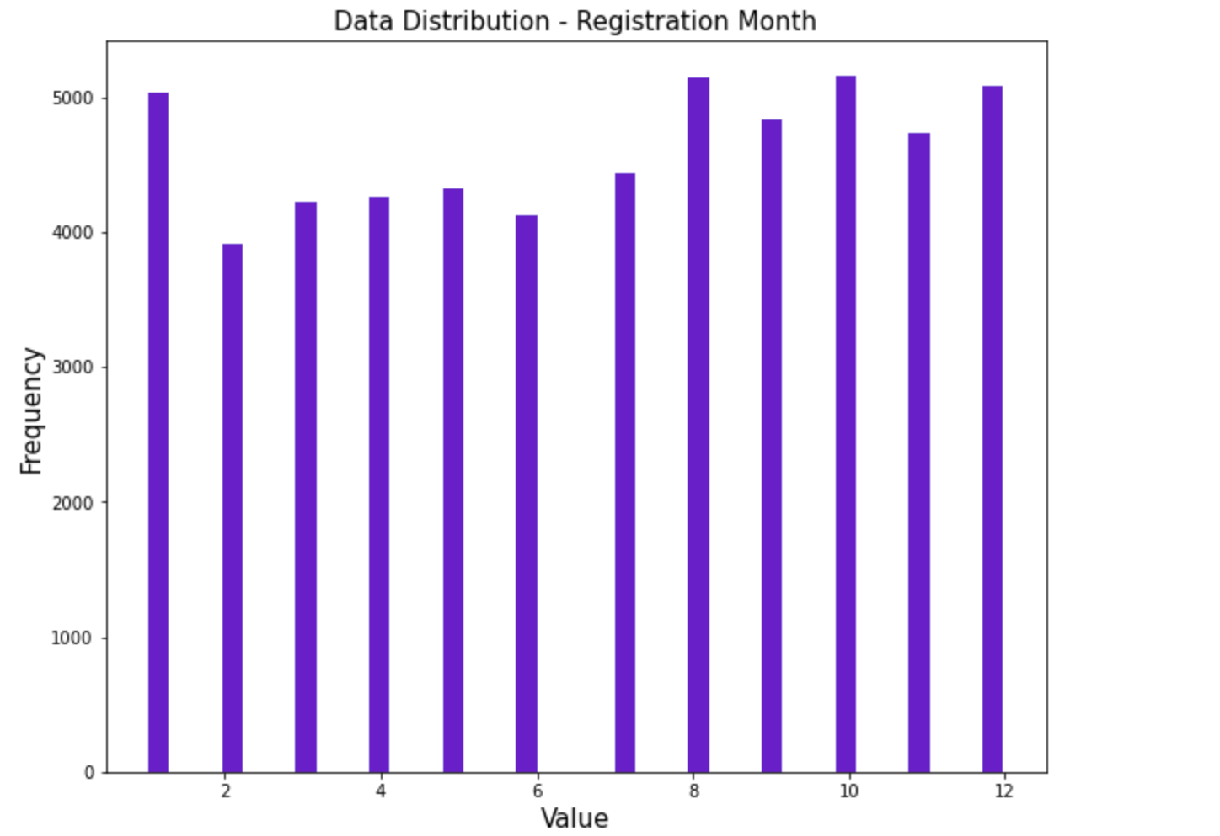
Univariate Analysis
As the data distribution cannot be assumed as a gaussian distribution, we may not standardize the variable but we may normalize it to a normal scale such that there won’t be varying scales in the dataset and the algorithm we are using does not make assumptions about the distribution of the data

Slide 7
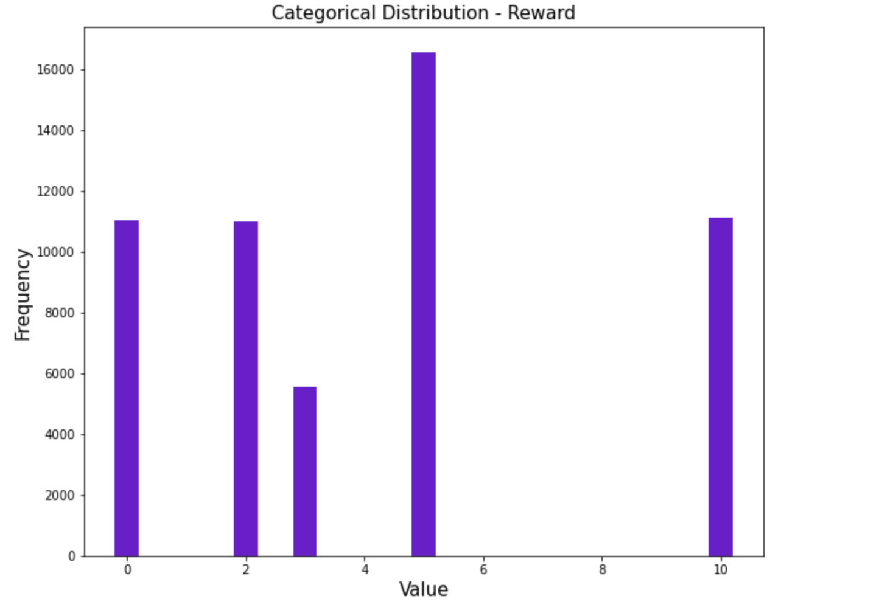
Univariate Analysis
Normalization will need to be done to this data

Slide 8
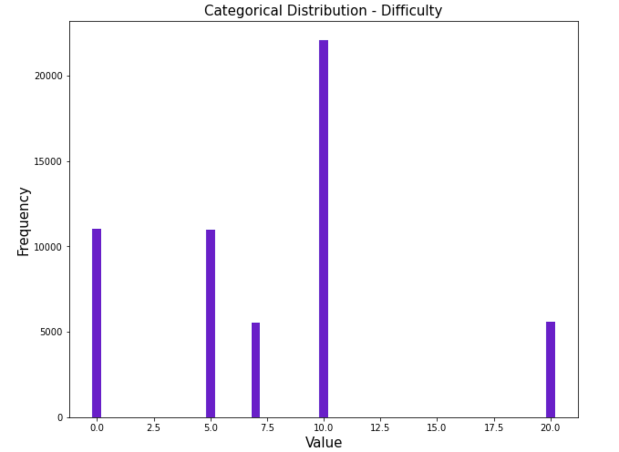
Univariate Analysis
Normalization will need to be done to this data

Slide 9
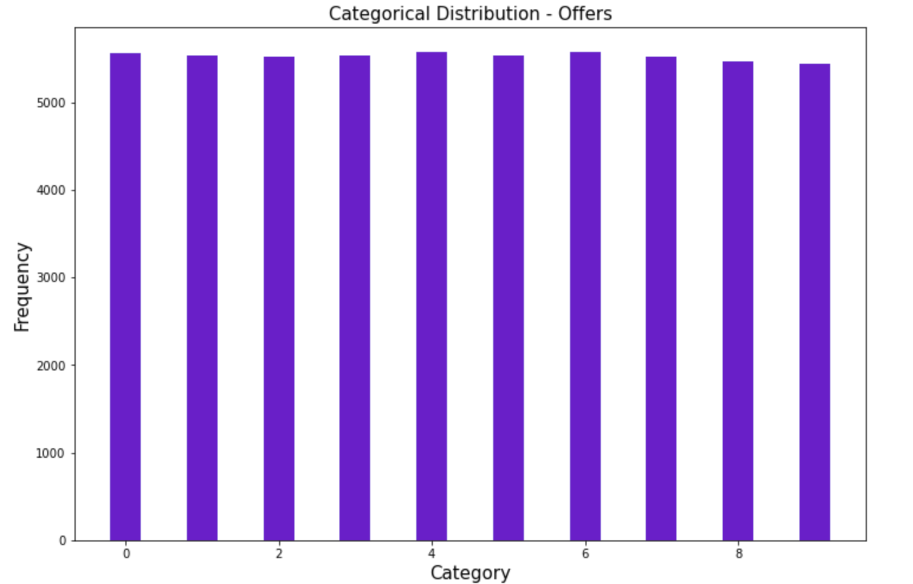
Frequency Tables
We have a balanced categorical data distribution for the variable ‘offers’ which can be encoded later using any suitable encoding scheme.

Slide 10
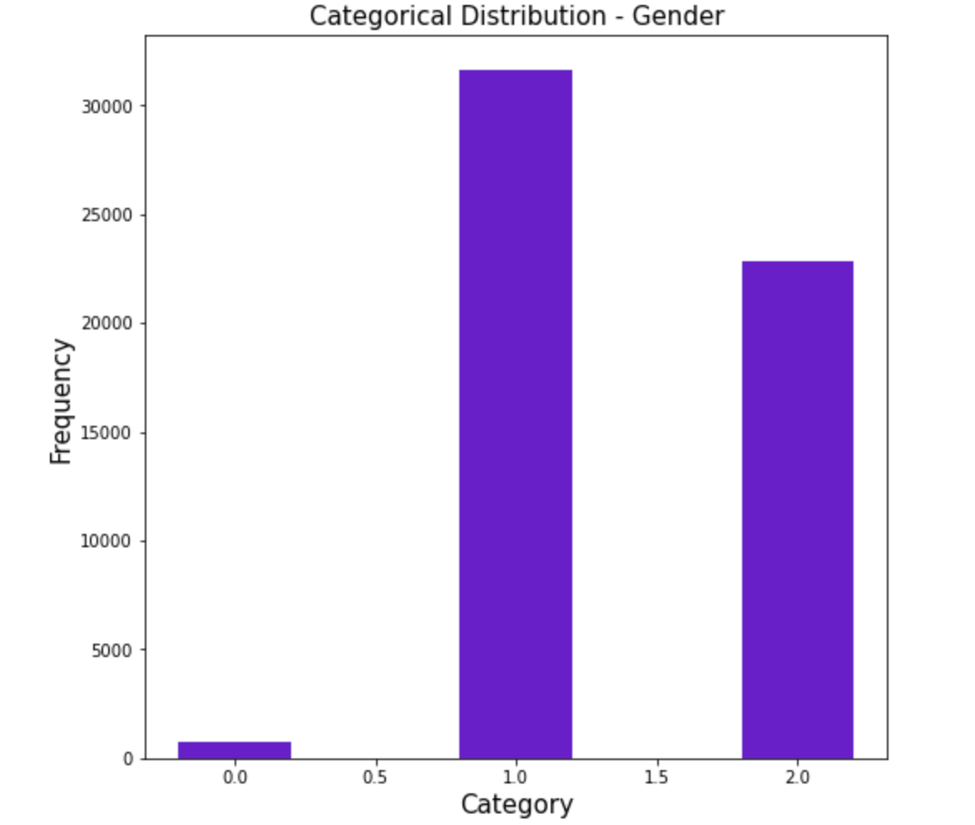
Frequency Tables
We have an imbalanced categorical data distribution for the variable ‘gender’ which can be encoded later using any suitable encoding scheme. The first category (‘other’) is the least occurring and hence, its influence on the target class can be assumed to be low. Also, just because the variable has a class imbalance, doesn't necessarily mean it isn't correlated with the target variable.

Slide 11
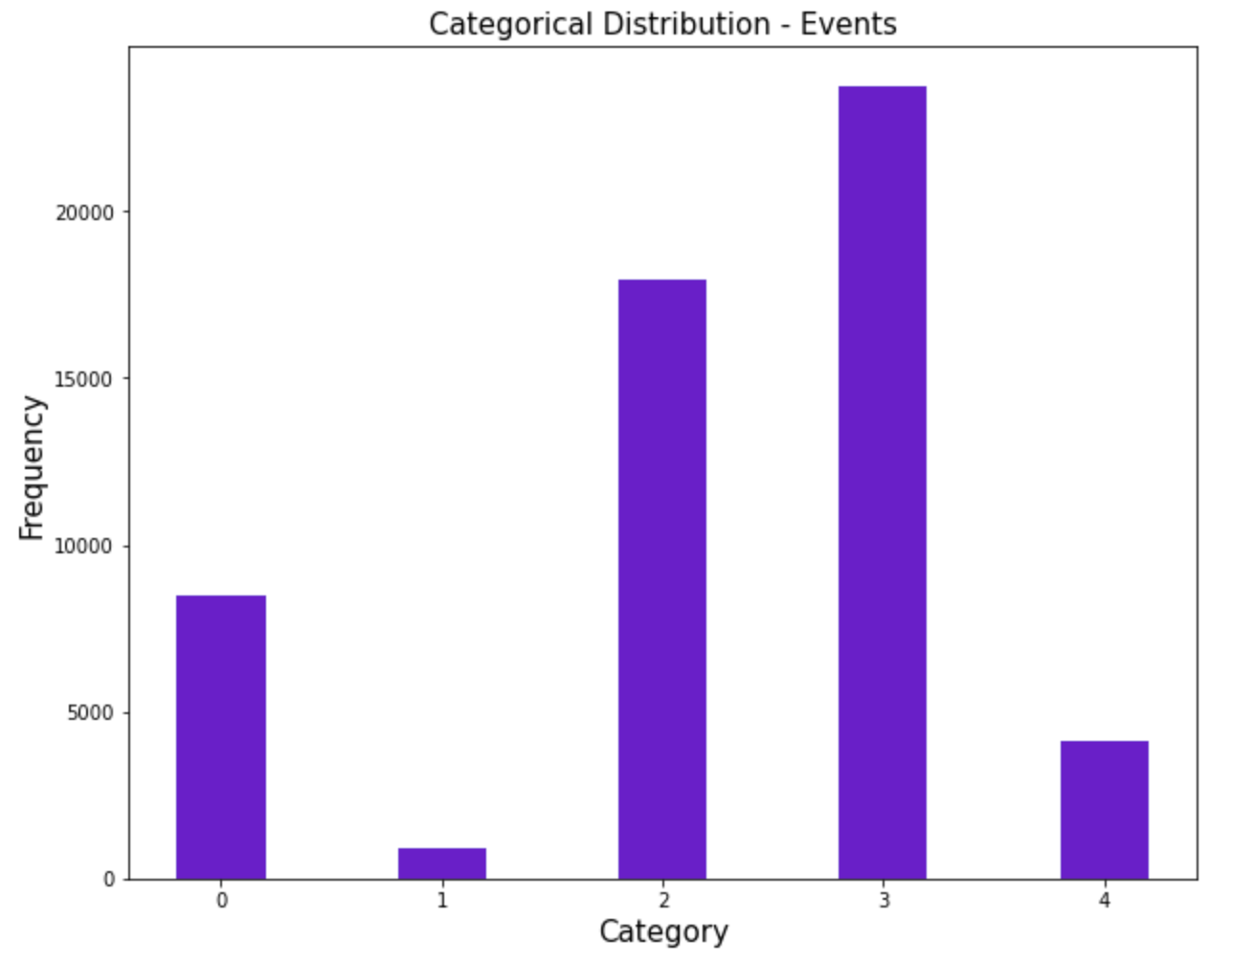
Frequency Tables
Our dataset is imbalanced. The event 'offer viewed' and 'green flag' are the least occurring events compared to the other events.

Slide 12
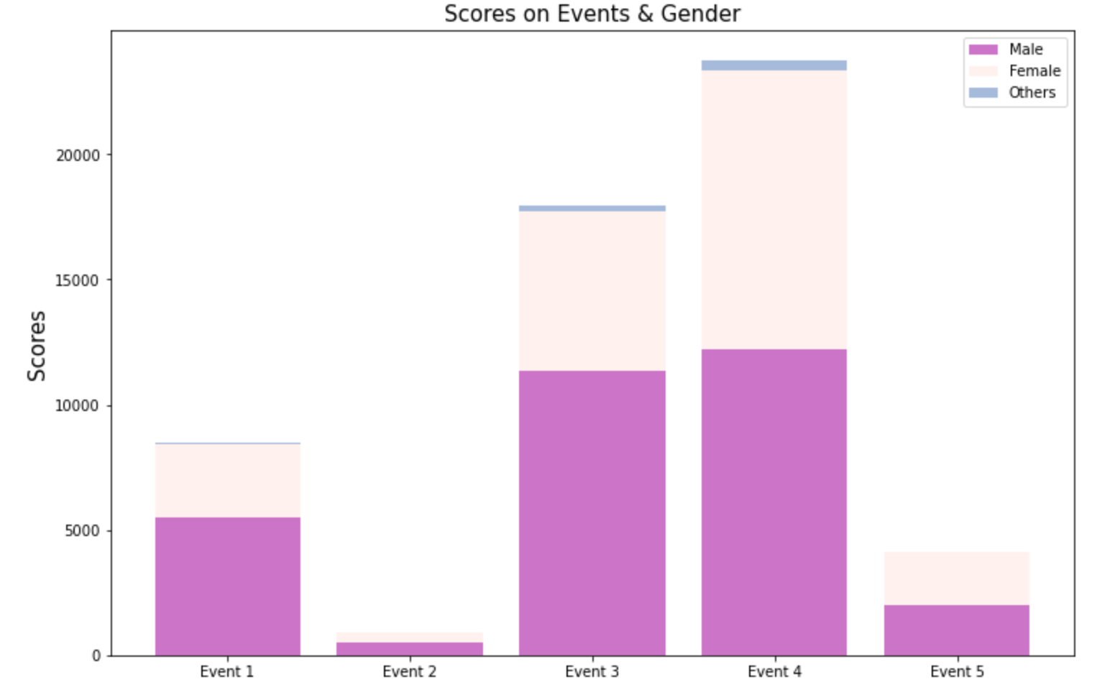
Bi-variate Analysis-Event ID and Gender
Looks like there is no correlation between the Event ID and Gender

Slide 13
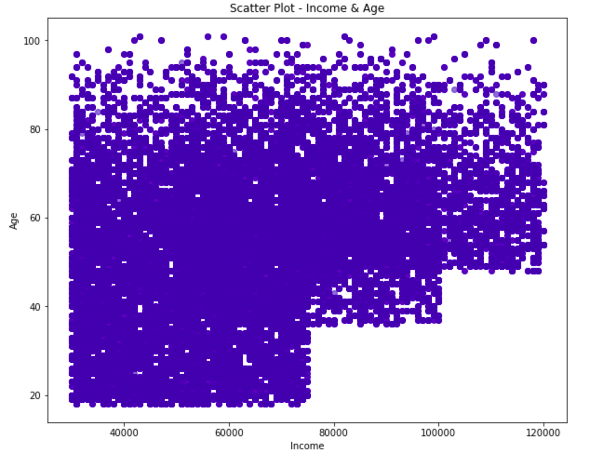
Bi-variate Analysis-Age and Income
We can observe from the figure that there is a stepwise increase in the income as the age value increases. But we may not be bothered about the same as it’s not a linear correlation.

Slide 14
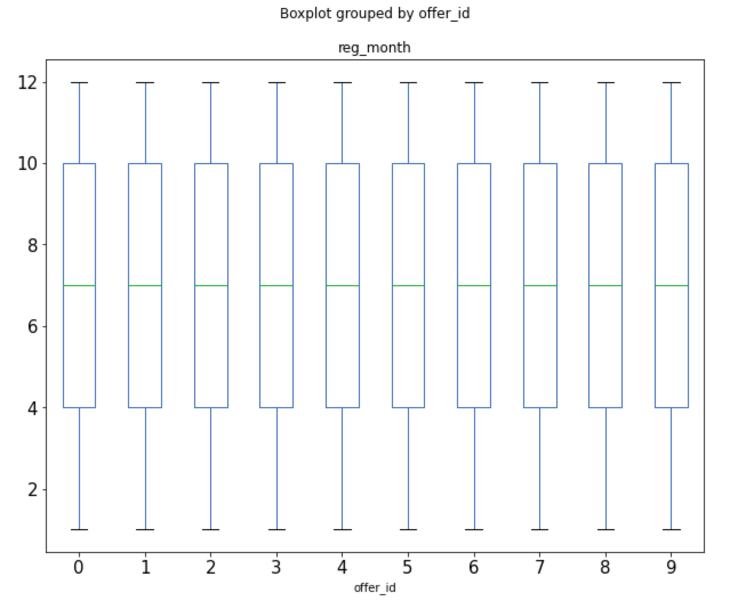
Bi-variate Analysis-Offer ID & Registration Month
Correlation among the variables can be inferred from the graph, thus we may try modeling without and with the variable ‘reg_month’. We can also infer that there are no outliers.

Slide 15

Outlier Detection
I used the mathematical function ‘Z-score’ to detect the outliers in the dataset. While calculating the ‘Z-score’ we re-scaled and centered the data and look for data points which are too far from zero. These data points which are way too far from zero will be treated as the outliers. We have set a threshold of 3 and -3 i.e. if the Z-score value is greater than or less than 3 or -3 respectively, that data point will be identified as outliers.
We found that there were no outliers to treat using this function.

Slide 16

Multi-Dimensional Scaling
Multidimensional scaling is a means of visualizing the level of similarity of individual objects of a dataset. It is used to translate information about the pairwise distances among a set of n objects or individuals into a configuration of n points mapped into an abstract Cartesian space.
We may use this method to scale our dataset dimension into just two components such that the relative distance between the data points are maintained. And then we may scatter plot each class in the dataset into the x-y plane. This may give us a narrow idea about the underlying structure of each class in the dataset.

Slide 17
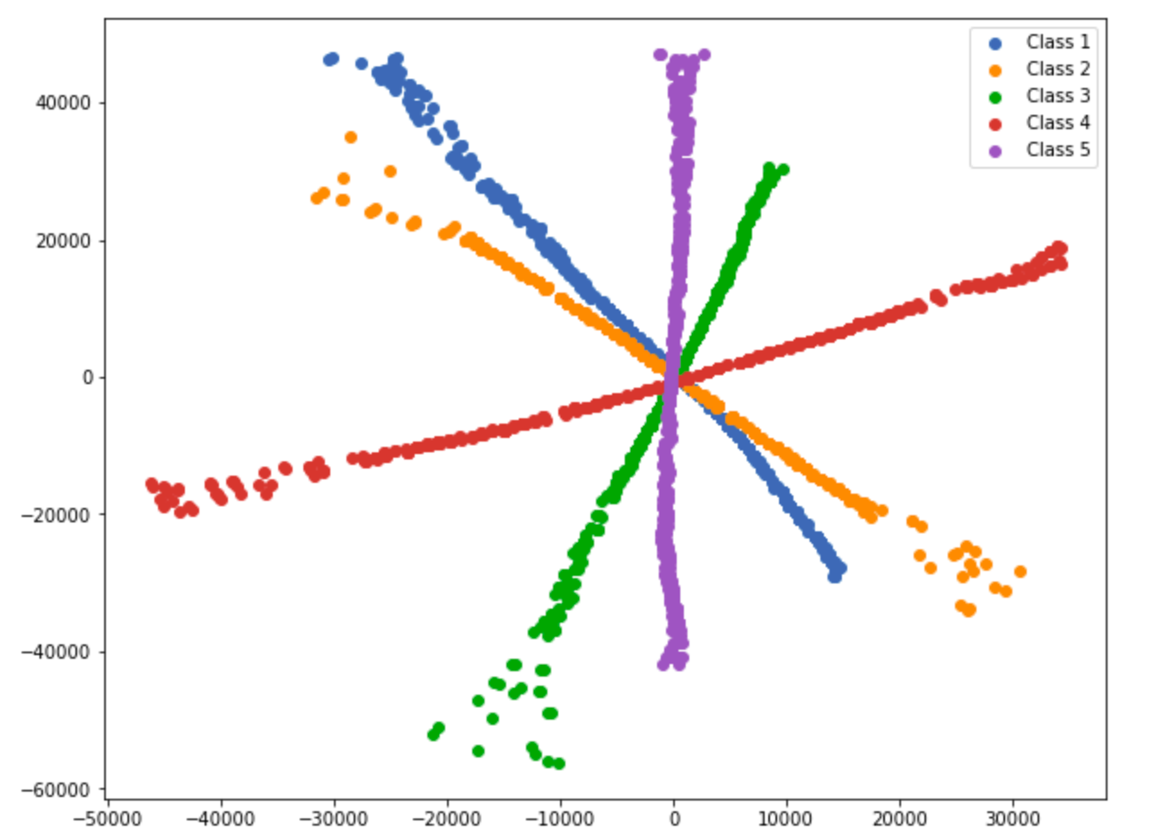
Multi-Dimensional Scaling
From the figure, we can observe that each class in the dataset is separable and is suitable for classification problems. And, from the structure of the data points we can infer that we may need to use a nonlinear function or model to solve the same.

Slide 18

Steps for next week
I will try to use variable standardization and normalization to scale the data variable, to transform complex non-linear relationships into linear relationships, to normalize skewed distributions etc.
As we have analyzed in the univariate analysis stage, some of our data variables requires standardization so as to avoid its skewed nature and some requires normalization for scaling down the data.
I think ultimately, we will need to create a model with the given data before we train the model and use a DNN as a benchmark model because it can perform well on large data sets and is suited well for multiclass classification.

